Slide 1
Intrusion Warning System using AI
Alert !!!
Student: Nhan Nguyen
Instructor: Nghia Tu
Class: 22Python01

Slide 2
-Contents-
01
02
03
04
Introduction
Features
Ideas, components
What it can do?
Future Developmetns
Conclusion
Ideas for upgrade and new features
What I have learned in this course?

Slide 3
01
-Introduction-
Alert !!!

Slide 4
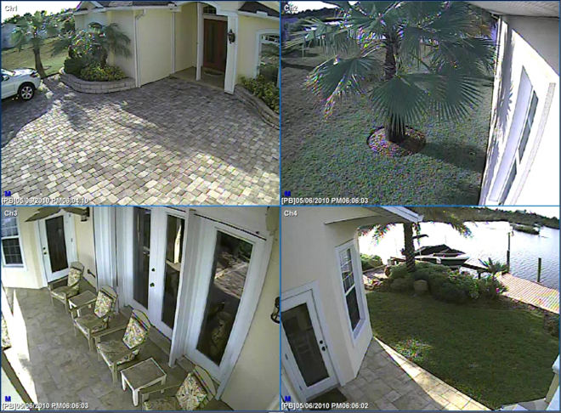

-Ideas-
House Security
Restricted Area

Slide 5
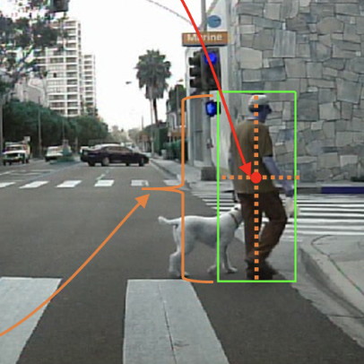
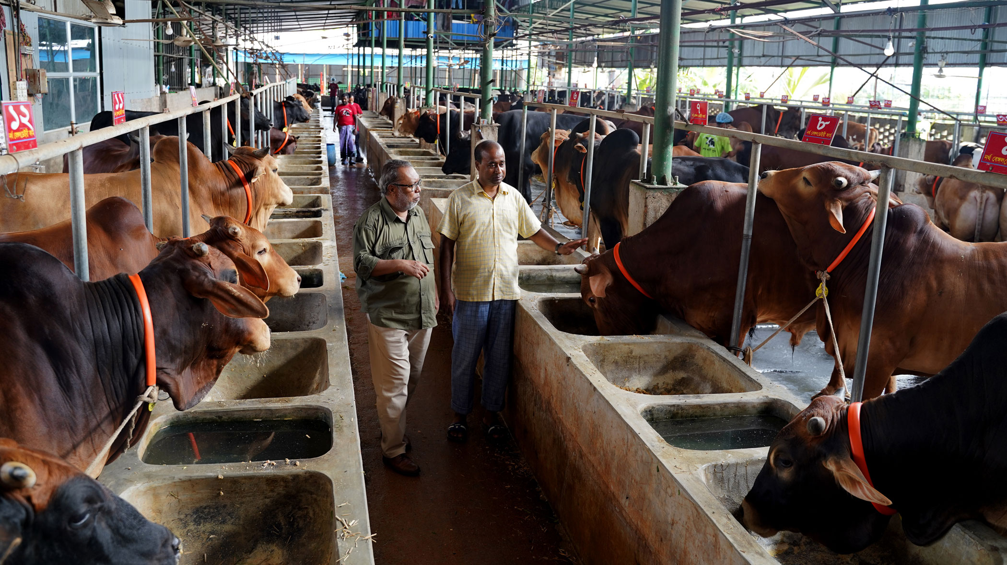
-Ideas-
Intruder Detection
Pedestrian Detection
Raspberry Pi 4 Model B (8Gb RAM)

Slide 6
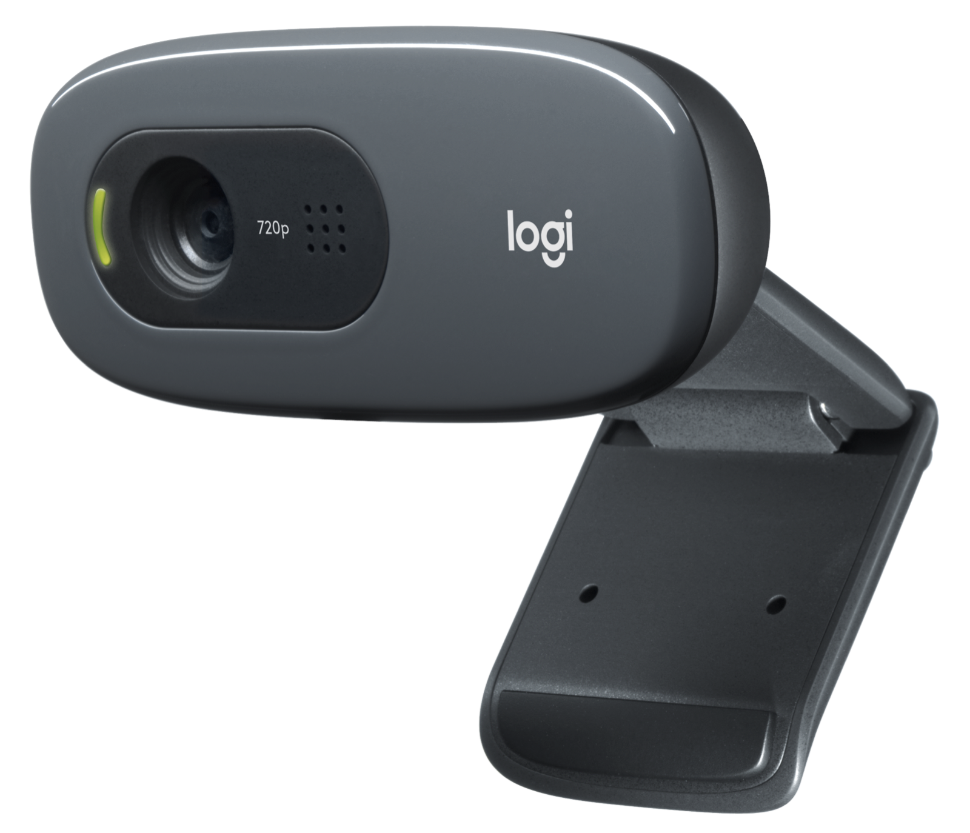
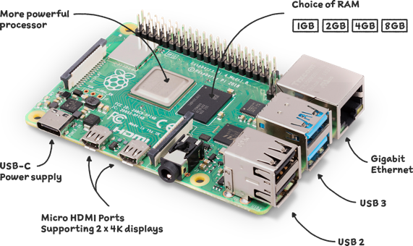
-Hardware-
Raspberry Pi 4 Model B (8Gb RAM)
Logitech Webcam

Slide 7
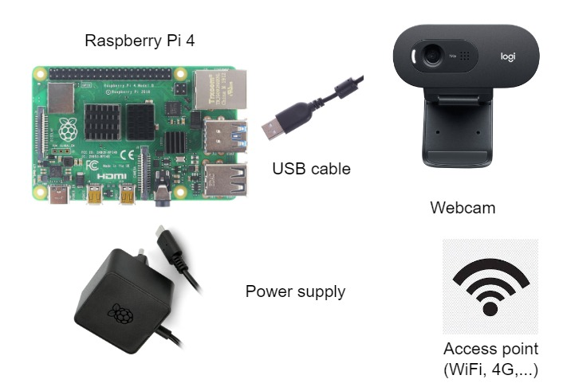
-Hardware-
Wiring

Slide 8

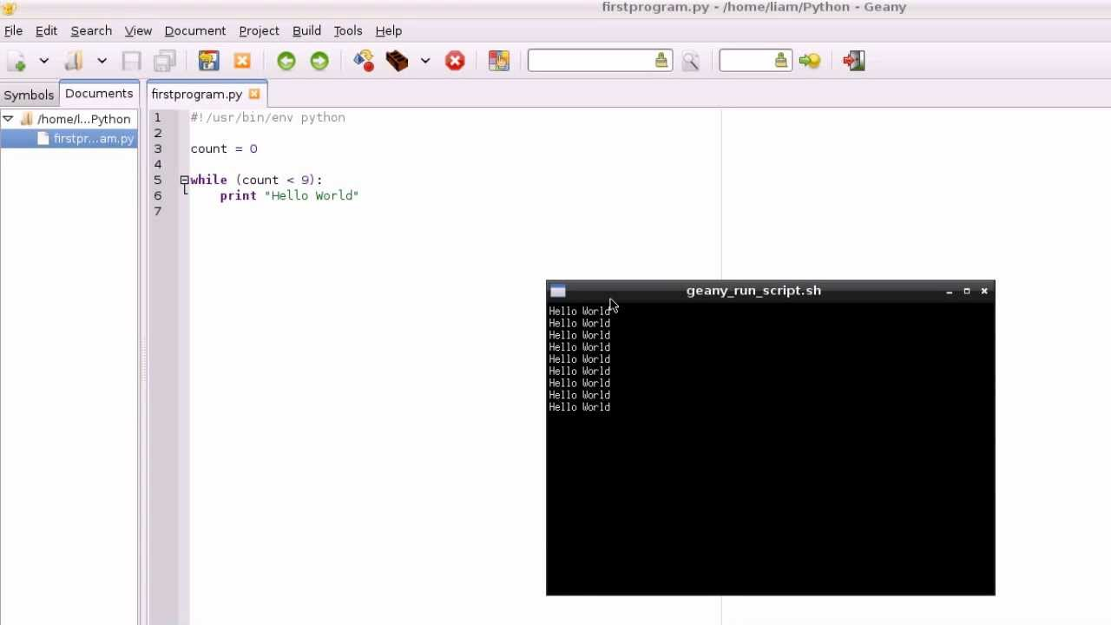
-Software-
Pycharm on Windows
Geany on Raspberry Pi OS

Slide 9
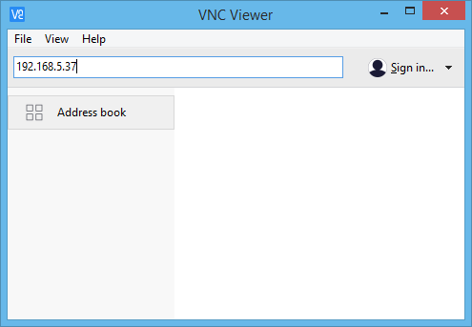
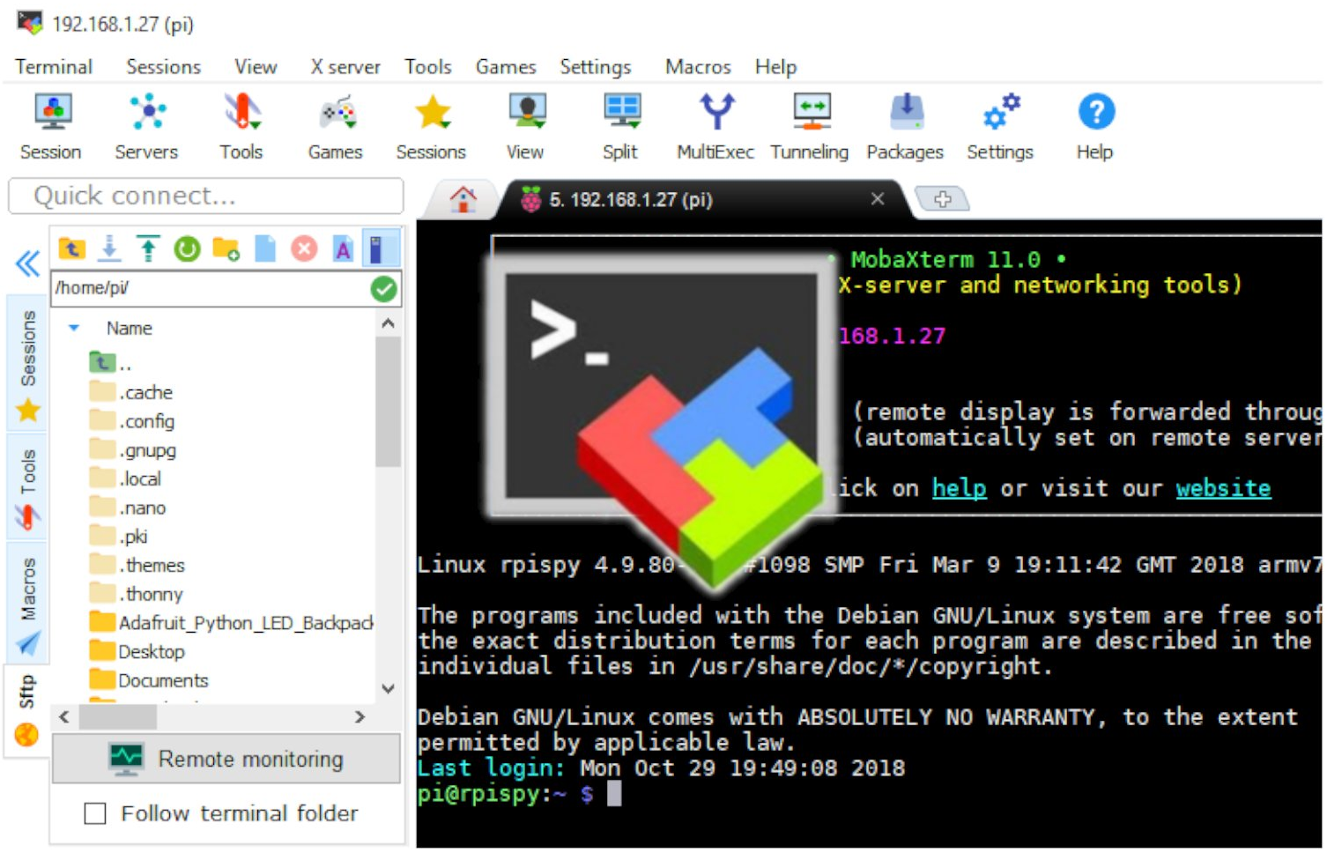
-Software-
VNC Viewer
MobaXterm terminal

Slide 10
02
-Features-
Alert !!!

Slide 11
-Pipeline-
Read
Detect
Filter
Display
Send
Human
Alert
Telegram
Camera
Object

Slide 12
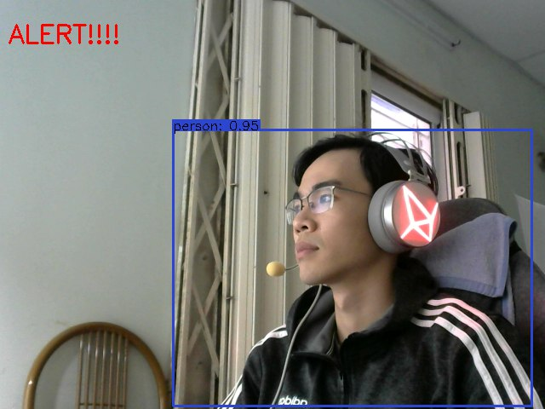
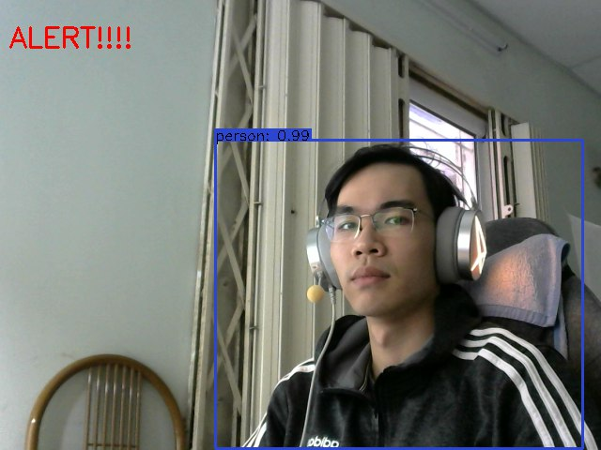
-Human detection-

Slide 13
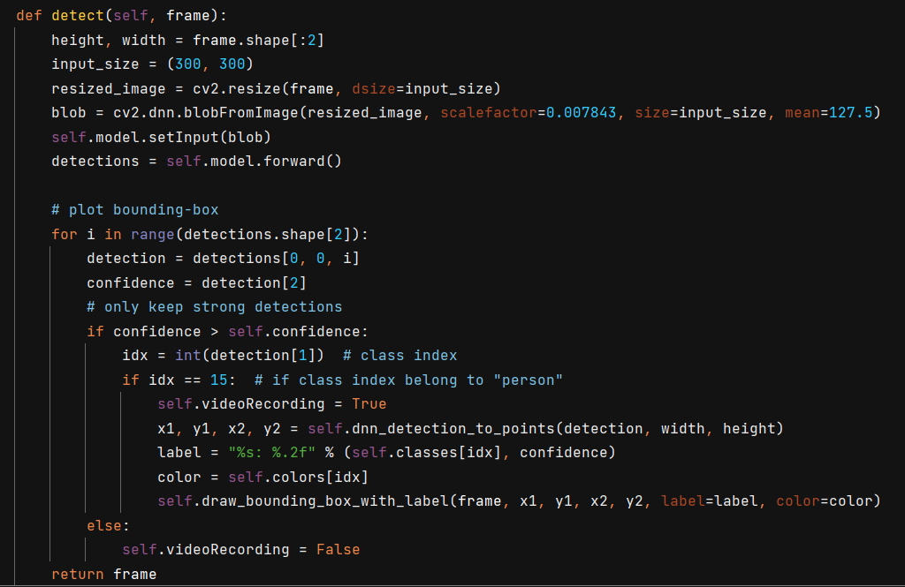
-Human detection-

Slide 14
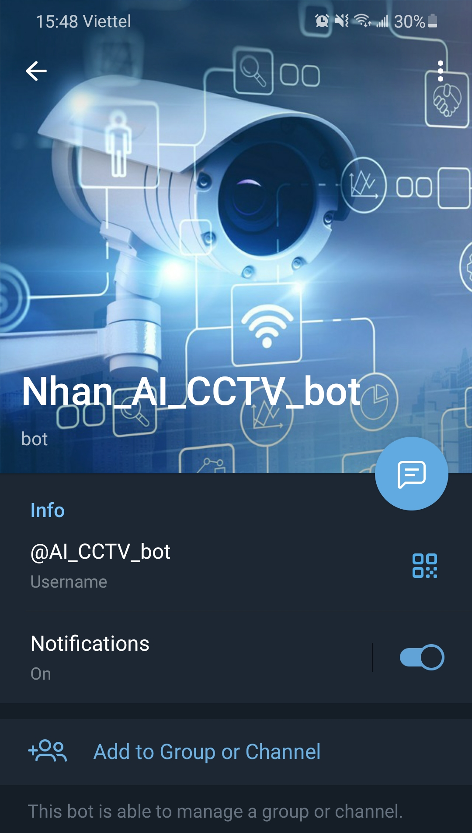
-Bot-

Slide 15
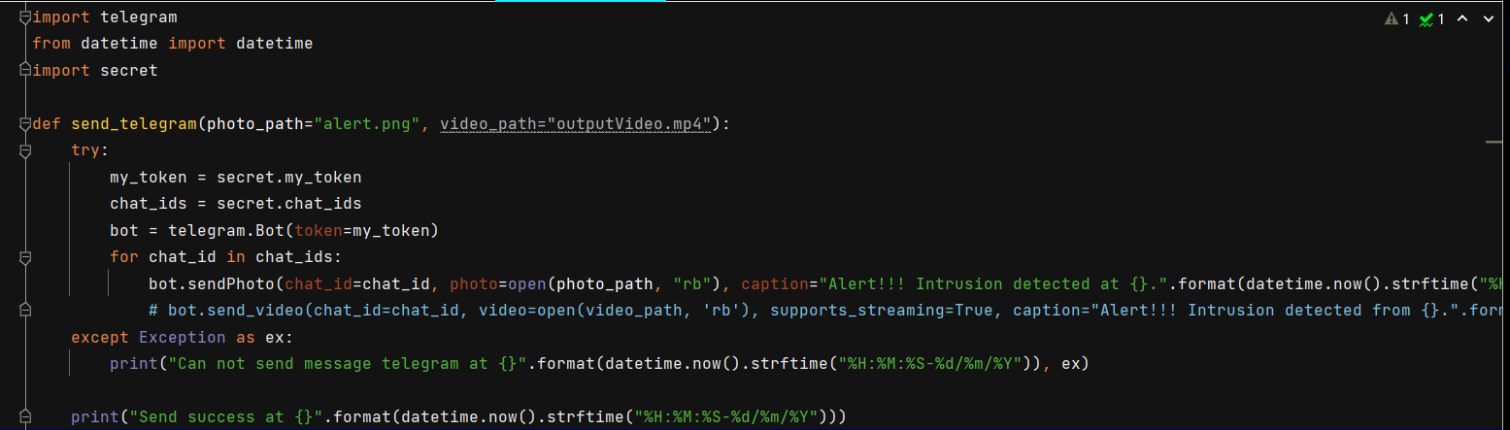
-Bot-

Slide 16
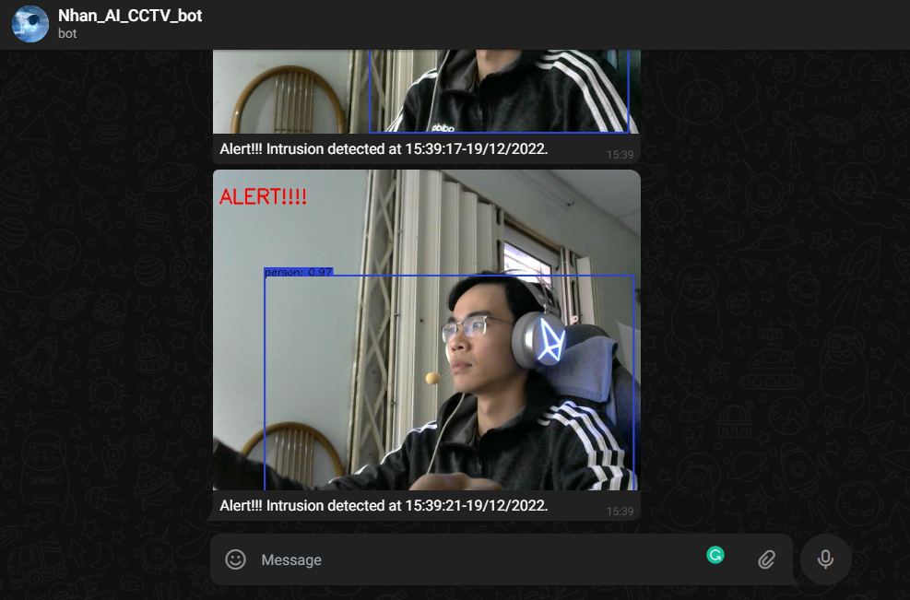
-Alert-
Alerts with photos are sent immediately to Telegram

Slide 17
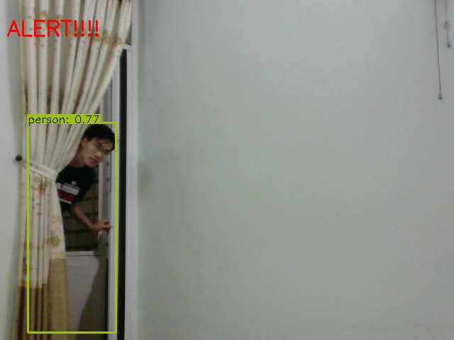
-Demo-
Detect and alert when someone goes in the area.

Slide 18
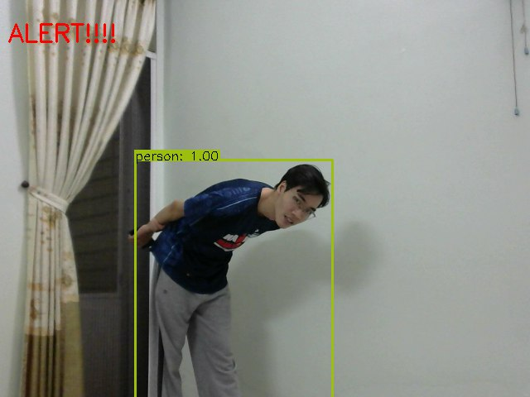
-Demo-
Accurate detection of human object

Slide 19
03
-Future Developments-
Alert !!!

Slide 20
-Future Developments-
Video
Night Vision
Facial Recognition
Record a short clip and send to users
Improve quality
to work in poor light condition
Detect family members or strangers
Sound, light
More Object
Photo’s metadata
Alert system to better notify
Custom object to detect for users (dog, cat, vehicle, etc…)
Include more information to the photo (date/time, GPS, weather, etc…)

Slide 21
04
-Conclusion-
Alert !!!

Slide 22
-Conclusion-
Python language
AI application
Libraries
Practice and apply Python programming language and OOP
Know the step of building an AI application
Image and video processing (OpenCV, Numpy, etc…)
Hardware
API
Embedding Python code into Raspberry Pi
Connect with users via third-party apps (Telegram, Gmail...)

Slide 23

-Thanks!- Q&A
GitHub: https://github.com/nvminhnhan/IntrusionWarning_MobileNet

